Slide 1
Real-Time Object Detection on Edge Devices with YOLO v4-Tiny Framework.
A Lightweight Approach for Real-Time Object Detection on edge devices.

Slide 2
Importance of Real-Time Object Detection & Edge Deployment
Real-World Applications: Critical for surveillance, autonomous vehicles, healthcare, and robotics.
Time-Sensitive Decisions: Enables instantaneous responses in dynamic environments.
YOLO: You Only Look Once state of the art architecture for Object Detection.
YOLOv4-Tiny Benefits: Optimized for speed and lightweight deployment on edge hardware.

Slide 3
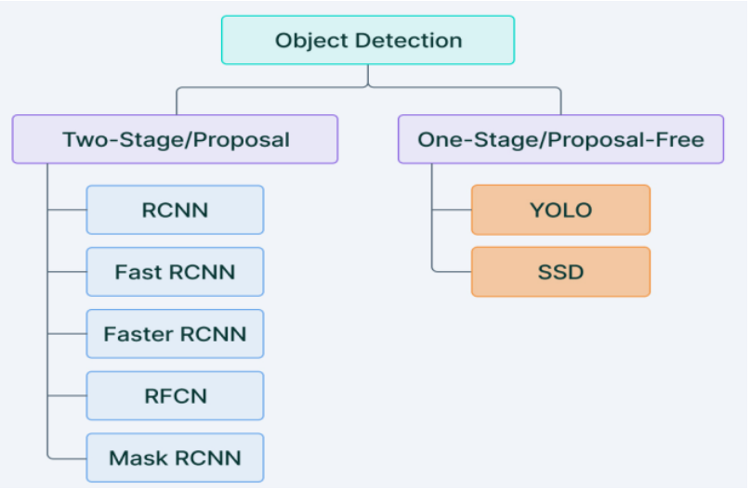
Object Detection before YOLO

Slide 4
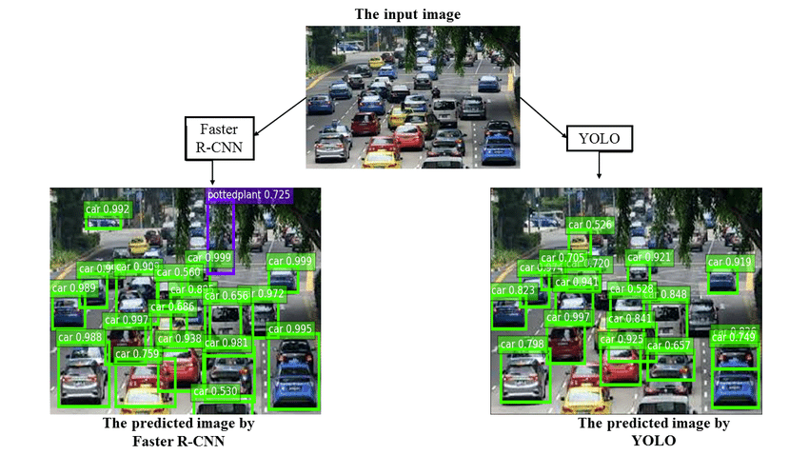
Why YOLO was revolutionary!
YOLO treats object detection as a single regression problem, eliminating region proposals.
It processes the image in one pass through network, simultaneously predicting bounding boxes and class probabilities.

Slide 5
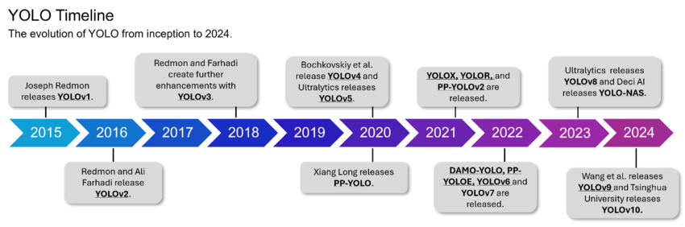
Timeline of YOLO evolution

Slide 6
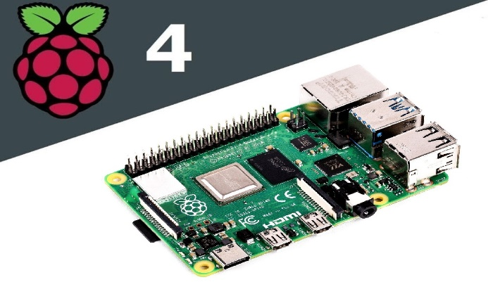
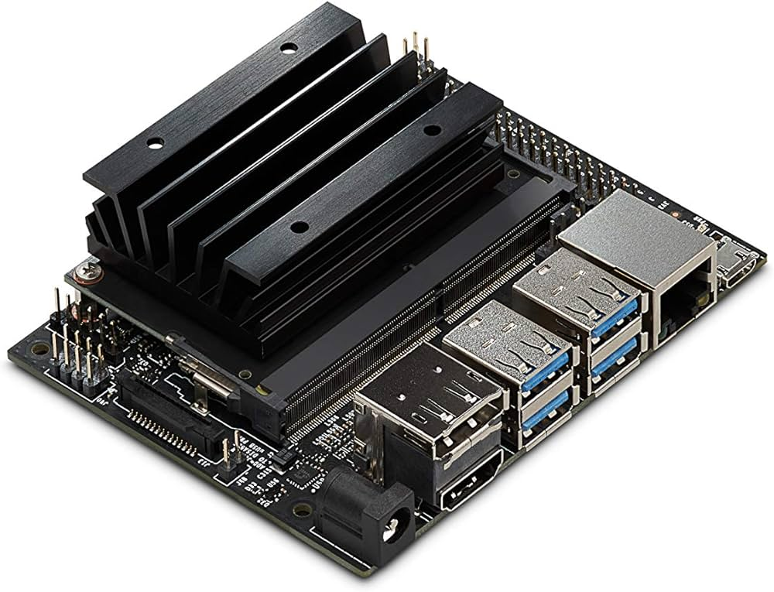
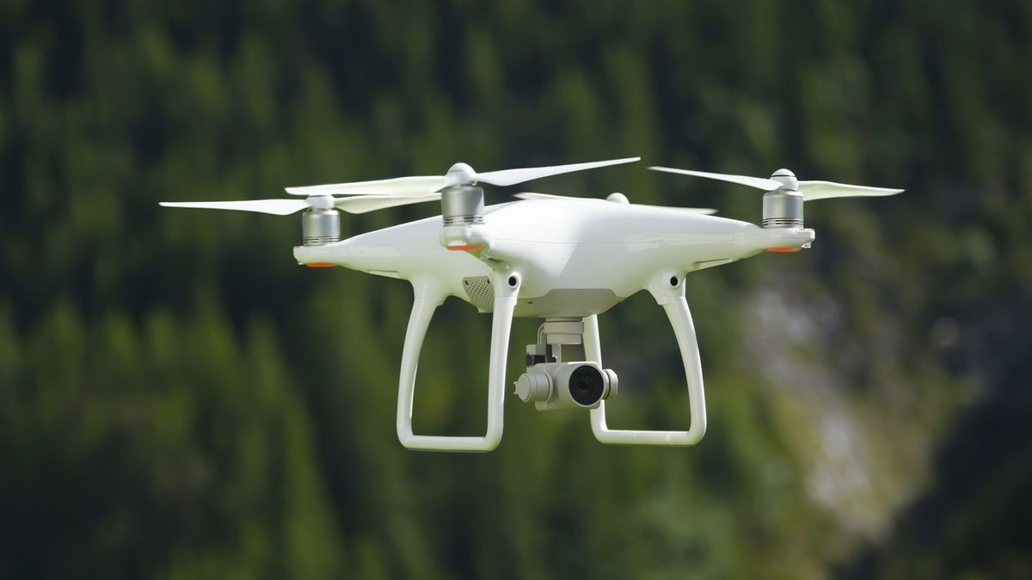
Introduction to YOLOv4-Tiny
YOLOv4-Tiny is a lightweight version of YOLOv4.
Uses fewer layers and a smaller backbone.
Sacrifices some accuracy compared to YOLOv4, for better real-time detection.
Faster Inference and Edge Friendly.

Slide 7
Object Detection in YOLOv4-Tiny
YOLOv4-Tiny resizes images to 416x416 pixels for uniform processing.
The image is split into S×S grid for object localization (initially S = 7).
Each grid with B Bounding Box (S×S×B total box).
Grid belonging to centre of object will do detection.
CSPDarknet53-Tiny efficiently extracts features.
FPN based neck for feature pooling.
Detection head operate at two scales (13x13 and 26x26) for multi-scale object detection.
Loss Function optimizes localization, confidence, and classification, leveraging CIoU for better box regression.
Non-Max Suppression (NMS) removes redundant boxes, ensuring accurate results.
Includes BoF and BoS.

Slide 8
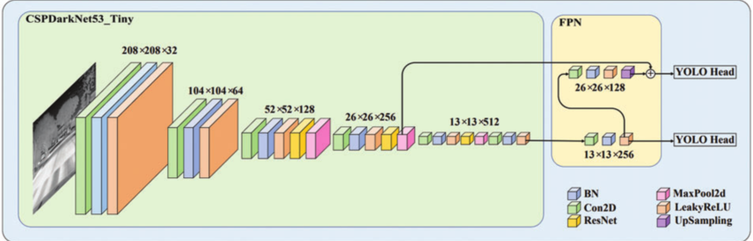
YOLOv4-Tiny architecture
It has 3 components.
BACKBONE (YOLOv4 based CSPDarknet53-Tiny)
NECK (Feature Pyramid Network (FPN))
HEAD (Similar to YOLOv3 and YOLOv4)

Slide 9
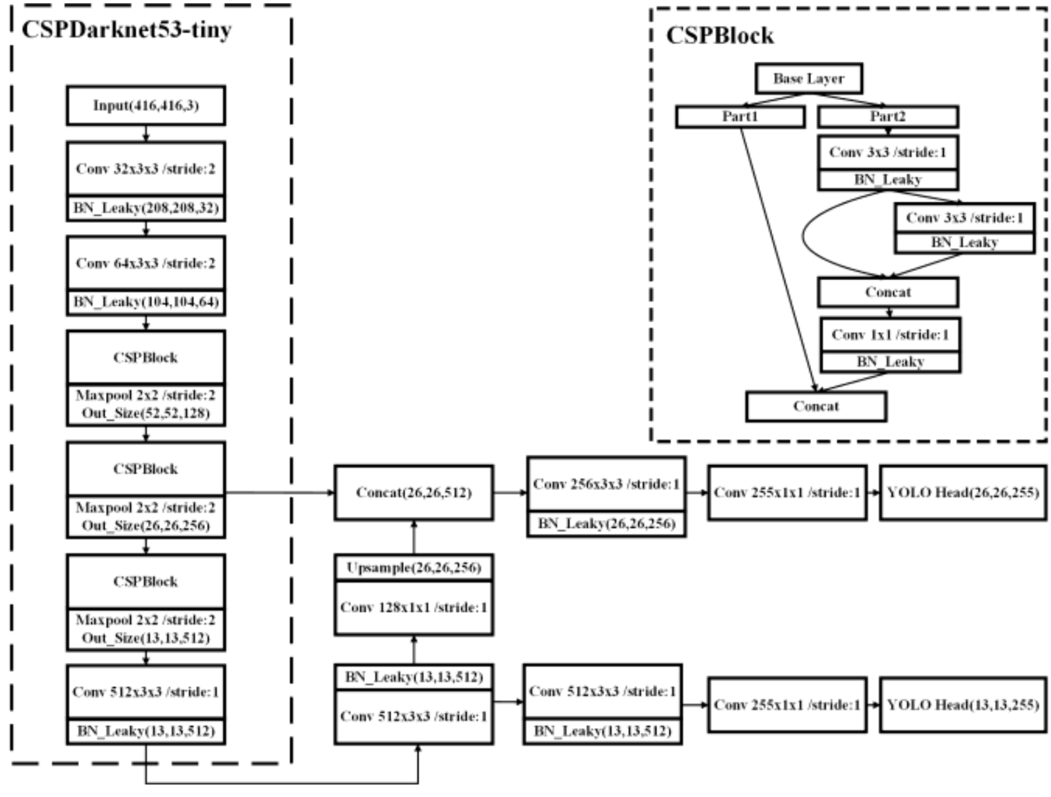
Backbone of YOLOv4-Tiny

Slide 10
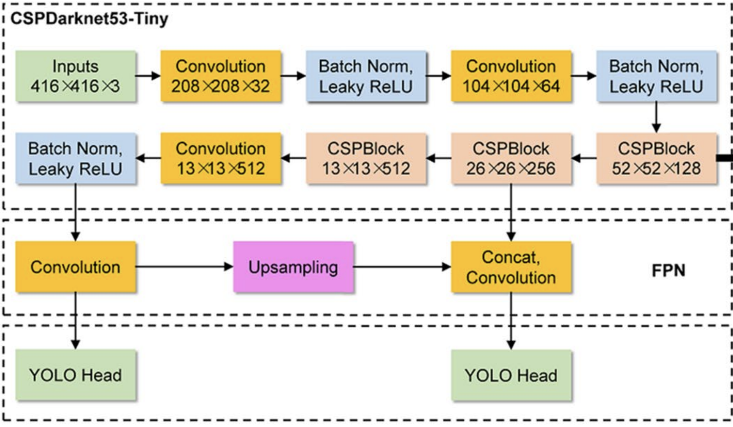
Neck of YOLOv4-Tiny
Neck uses Feature Pyramid Network (FPN) technique for feature pooling.
Doesn’t use Spatial Pyramid Pooling (SPP) and Path Aggregation Network (PANet) as used in YOLOv4.

Slide 11
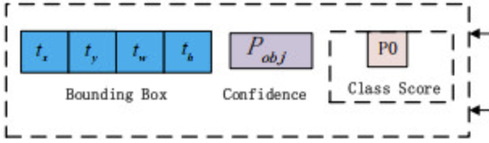
Head of YOLOv4-Tiny
Two different scales feature maps that are (13×13×255) and (26×26×255) used to predict the detection results.
Head consist of Bounding Box co-ordinates, Confidence Score, and Class probabilities.
13×13×255 head used for large objects and 26×26×255 head for small objects.

Slide 12
Performance Optimization
Bag of Freebies (BoF)
Optimization technique during training and inference.
Doesn’t Increase inference time.
Increase training time.
Ex. - CutMix, Mosaic Augmentation, Self Adversarial Training (SAT).
Ex. - Cosine Annealing Scheduler: change learning rate parameter
Bag of Specials (BoS)
Modules increasing accuracy.
Increase inference time by small amount.
Ex. - Cross Stage Partial Connections (CSP)

Slide 13

Loss Function for YOLOv4-Tiny
$$C_{total }=C_{bbox}+C_{objectness}+C_{class}$$
$C_{bbox}= \sum_{i=1}^{N}{1_{obj}^{i}}$.($1−CIoU\left(b_{i},b_{i}^{gt}\right))$
$CIoU(b,b_{gt})=IoU(b,b_{gt})$ - $\frac{ρ^{2}(b,b_{gt})}{c^{2}}$ - $α.θ$
$C_{objectness}$ = $\sum_{i=1}^{N}{{ [ 1}_{obj}^{i}}$.$log⁡(p_{i}^{.})$ + $1_{no_obj}^{i}$.$log⁡(1−p_{i}^{.})$]
$C_{class}$ = $\sum_{i=1}^{N}{1_{obj}^{i}. \sum_{c=1}^{C}{[ − y_{c}}}$.$log⁡(p_{c}^{.})$ – $(1−y_{c})$.$log⁡(1−p_{c}^{.})$]
where
$1_{obj}^{i}$ - Indicator function, 1 if object is present in the i-ith anchor. $ρ^{2} − \text{Squared} \text{distance} \text{between} \text{the} \text{centers} \text{of} b\text{and} b_{gt}$
$b_{i}$ - Predicted bounding box $θ −$ Aspect ratio consistency
$b_{i}^{gt}$ - Ground truth bounding box $p_{i}^{.}$ - Predicted objectness score
$c$ - Diagonal length of the smallest enclosing box. $1_{no_obj}^{i}$ - Indicator for no object
$y_{c}$- Ground truth class label (1 for the correct class, 0 otherwise) $C$ – Number of classes

Slide 14
Evaluation Metrics
METRIC | YOLOv4 | YOLOv4-Tiny
Inference Speed | ~2 FPS | ~14 FPS
Precision | ~80% | ~70%
Recall | ~75% | ~68%
mAP@[0.5] | ~55% | ~45%
F1-Score | ~77% | ~71%
Comparison of metrics for YOLOv4 vs YOLOv4-Tiny were made on Raspberry pi 4b (4GB) w/o TPU

Slide 15
Tweaking YOLOv4-Tiny
Can we do better over vanilla implementation?
Answer is YES !!
Use of Tensor Processing Unit (TPU) like Google Coral or a Graphics Processing Unit (GPU).
Frame Skipping.
Quantization.
Model Pruning.
Above methods provide significant Improvement in speed.

Slide 16
What makes YOLOv4-Tiny Fast and feasible for edge device?
Use of fewer convolution layers than its counterpart YOLOv4.
Less complex CSP Block.
Use of LeakyReLU instead of Mish activation.
Fewer layers mean fewer parameters (~6 million vs ~63.6 million)
Use of FPN instead of SPP and PANet in neck for feature pooling.
Use of 2 heads instead of 3 heads for detection.
Less complex Loss/Cost Function.
Prioritizes speed, inference time, and efficiency over accuracy.

Slide 17
Conclusion
The less complex and lightweight version of YOLOv4-Tiny favors deployment on edge devices with resource constraints.
Model achieves high accuracy with an acceptable Inference Time, FPS, and other Evaluation Metrics which is acceptable and feasible for real-time object detection.

